Slide 1
Childhood Obesity in the UK
Problems and solutions
By: Haya AlSultan and Wisam Siyamek

Slide 2
Content
General information
Causes
Effects
Solutions
Conclusion

Slide 3
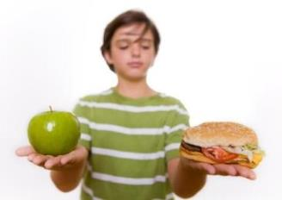
General information
Obese BMI is 30 and above
Obesity levels trebled
16%
(Abell 2015)
(Karnik et al 2012; NHS 2015)

Slide 4
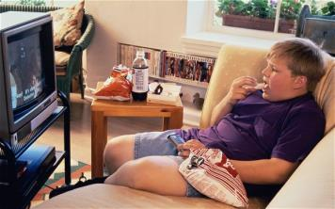
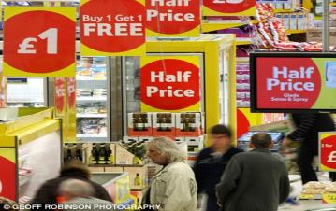
Causes
Sedentary life
Genetics
Environment
Food and drink industry
(Collins 2013)
(Asiantrader 2009)
(Karnik et al 2012; NHS 2015; The Guardian 2015)

Slide 5
Effects
Physical
Cardiovascular Diseases
Respiratory Problems
Discomfort
Psychological
Reduced Progress
Lower
self-esteam
Depression
(Karnik et al 2012; NHS 2015)

Slide 6
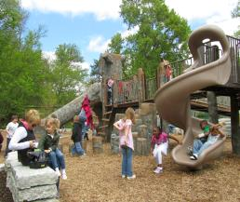
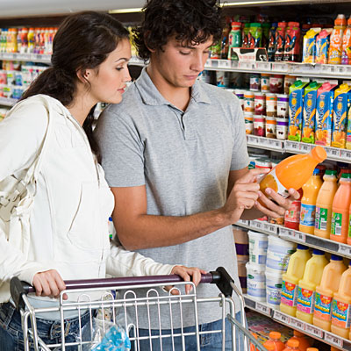
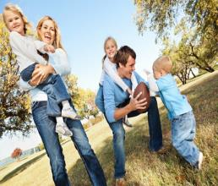
Solutions
Government
Businesses
Family
(Cre8play 2015)
(Health 2015)
(Aspire Charter Academy 2014)
(Karnik et al 2012; NHS 2015; The Guardian 2015)

Slide 7
Conclusion
2020
Boys
Girls
30%
27%
(BBC 2009)

Slide 8
References
Abell, A. 2015. Childhood obesity and the power of influencer strategy [Image]. Available at: http://www.buzzbinpadillacrt.com/childhood-obesity-and-the-power-of-in-influencer-strategy/ [Accessed: 1 December 2015].
Asiantrader. 2009. Buy-one-get-one-free deals may be banned to cut waste [Image]. Available at: https://www.asiantrader.biz/industry-news/Buy-one-get-one-free+deals+may+be+banned+to+cut+waste/197 [Accessed: 2 December 2015].
Aspire Charter Academy. 2014. Try Out These Family Activities for Fall Fun [Image]. Available at: http://aspirecharteracademy.com/try-out-these-family-activities-for-fall-fun/ [Accessed: 2 December 2015].
BBC News. 2015. BBC News - Child obesity 'is levelling off' [Online]. Available at: http://news.bbc.co.uk/1/hi/health/8338456.stm [Accessed: 1 December 2015].
Cre8play. 2015. Eden Park Cincinnati [Image]. Available at: http://www.cre8play.com/custom_play/twin-lakes-park-cincinnati-oh/ [Accessed: 1 December 2015].

Slide 9
References
Health. 2015. 11 Ways to Pick Out Healthy Food [Image]. Available at: http://www.health.com/health/gallery/0,,20413490,00.html [Accessed: 2 December 2015].
Karnik, S. and Kanekar, A. 2012. Childhood obesity: a global public health crisis. International Journal of Preventive Medicine 3(1), pp. 1-7.
NHS. 2015. Britain: 'the fat man of Europe' [Online]. Available at: http://www.nhs.uk/livewell/loseweight/pages/statistics-and-causes-of-the-obesity-epidemic-in-the-uk.aspx [Accessed: 1 December 2015].
The Guardian. 2015. The Guardian view on obesity: there’s no way to sugar this pill. The UK government must act Editorial [Online]. Available at: http://www.theguardian.com/commentisfree/2015/oct/22/the-guardian-view-on-obesity-theres-no-way-to-sugar-this-pill-the-uk-government-must-act [Accessed: 29 November 2015].
Collins, N. 2013. Overweight children should watch less television, Nice claims [Image]. Available at: http://www.telegraph.co.uk/news/health/children/10397632/Overweight-children-should-watch-less-television-Nice-claims.html [Accessed: 4 December 2015].

Slide 10

Thank you for listening
Any questions?

